Slide 1
Static Analysis with Sonar
Keywords: Clean Code, Vulnerability, Bug, Security Hotspot, Code Smell

Slide 2
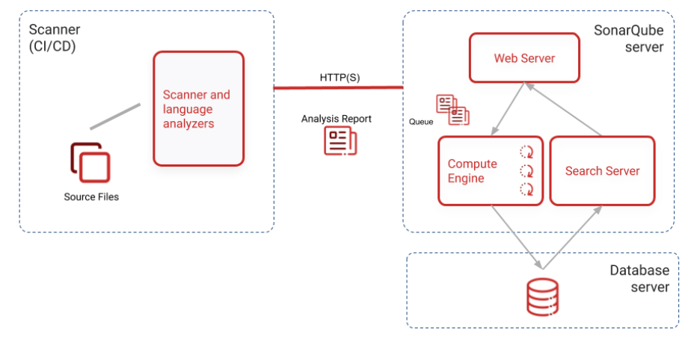
Sonar
Sonar consists of a Scanner and a Web application (self-hosted or SaaS).

Slide 3
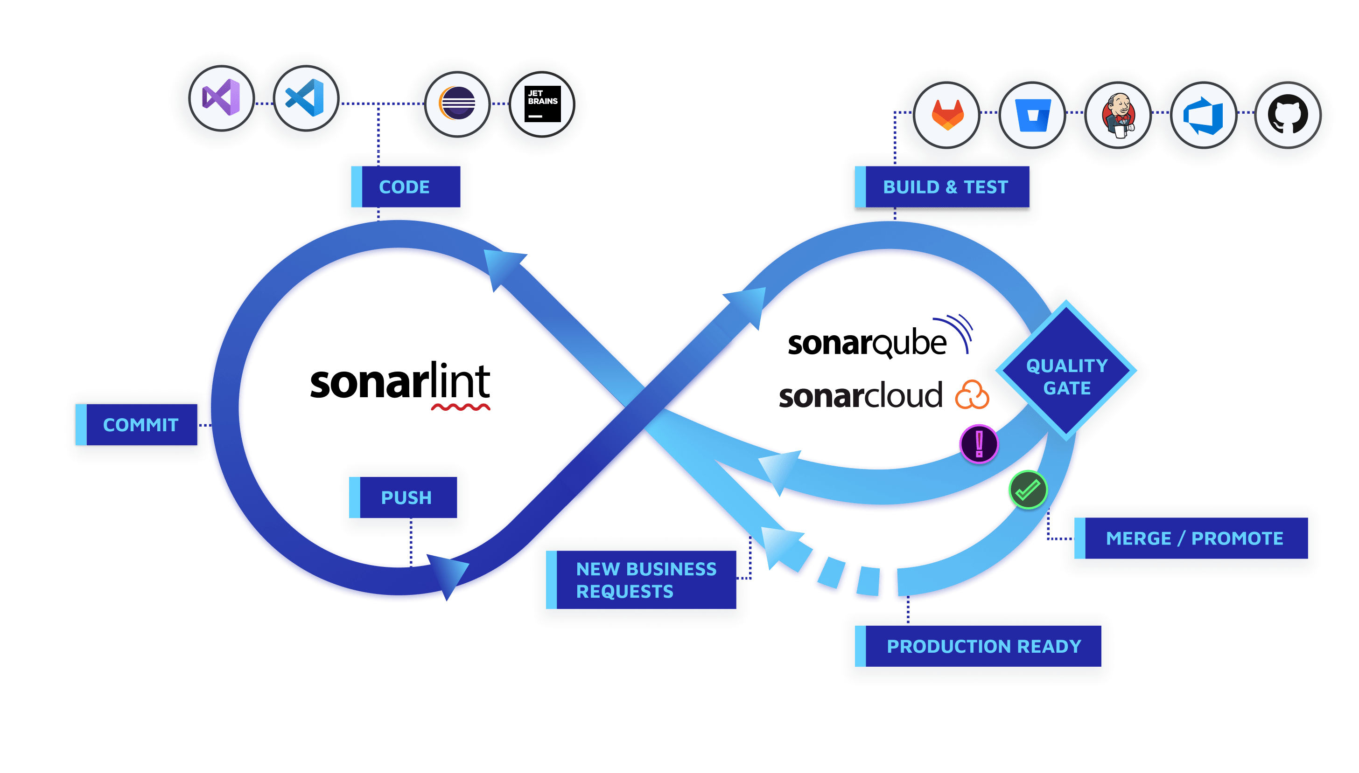
Where can I configure Sonar?
In a Pipeline, e.g., using CircleCi
In an IDE, e.g., using IntelliJ
You only need one token.

Slide 4
How does it work?
A Sonar project is related to a code project regardless of being in the same repository
You can configure exclusions in a property file in the code project or in the Sonar project
You can use scanners other than Sonar*
https://docs.sonarsource.com/sonarqube/latest/analyzing-source-code/importing-external-issues/importing-third-party-issues/

Slide 5
Where can I find the rules?
https://rules.sonarsource.com/
Where can I find the properties?
https://docs.sonarsource.com/sonarqube/latest/analyzing-source-code/analysis-parameters/

Slide 6
Example
Github
https://github.com/crcaguilerapo/static-analysis/pull/3
CircleCI
https://app.circleci.com/pipelines/github/crcaguilerapo/static-analysis
SonarCloud
https://sonarcloud.io/projects

Slide 7
References
https://docs.sonarsource.com/sonarlint/intellij/
https://docs.sonarsource.com/sonarqube/latest/

